Slide 1
HACKING THE GLITCH
Madhav Shah

Slide 2

Agenda
Who are Hackers.
Types of Hackers
OWASP TOP 10
Techniques of Hacking
Bug Bounty
Penetration testing

Slide 3
Who are Hackers?
A hacker is an individual who uses computer, networking or other skills to overcome a technical problem. The term also may refer to anyone who uses their abilities to gain unauthorized access to systems or networks in order to commit crimes.
Some hackers also try to manipulate system but they are black hat(we will learn it further)
Companies put millions of dollars to protect their system from data breach caused by black hat hacker

Slide 4
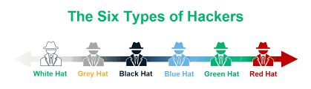
Types of Hackers

Slide 5
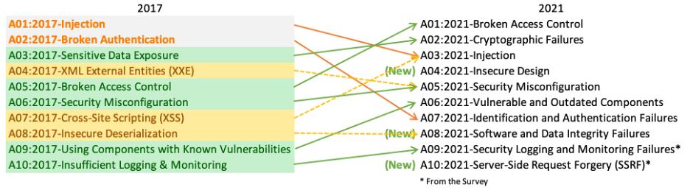
OWASP TOP 10

Slide 6
Techniques of Hacking
Key Logger
Denial of Service (DoS\DDoS) Attacks
Viruses and Trojans
Phishing
Bait and Switch Attack
Cookie Theft
Clickjacking Attacks
Fake W.A.P.

Slide 7
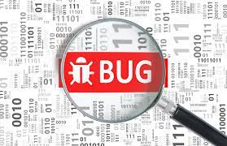
Bug Bounty
A bug bounty program is a deal offered by many websites, organizations and software developers by which individuals can receive recognition and compensation for reporting bugs, especially those pertaining to security exploits and vulnerabilities
A total of 662 researchers from 62 countries received bug bounty payouts last year, with the highest reward being of $132,500. Google has Vulnerability Reward Programs (VRPs) in place for multiple products, including the Chrome browser, the Android operating system, and the Google Play Store.

Slide 8
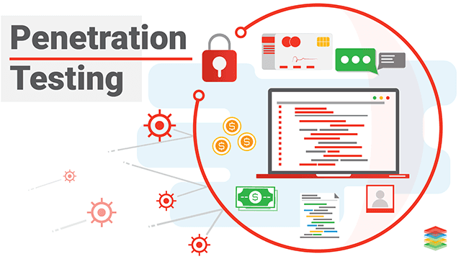
Penetration testing
A penetration test, or pen test, is an attempt to evaluate the security of an IT infrastructure by safely trying to exploit vulnerabilities. ... Instead of checking the windows and doors, they test servers, networks, web applications, mobile devices, and other potential entry points to find weaknesses.
Penetration Testing is broadly classified into 5 phases - Reconnaissance, Scanning, Gaining Access, Maintaining Access and Covering Tracks

Slide 9
Conclusion
Thereby we have learned about Who are Hackers, Types of hackers, techniques of hacking, OWASP TOP 10, Bug Bounty, Penetration testing

Slide 10
Thank You
~ Security used to be an inconvenience sometimes, but now it’s a necessity all the time.

